Slide 1
Software Interviews
What to expect
How to prepare

Slide 2
HAS THIS HAPPENED TO YOU RECENTLY?
You have been staring at a programming problem…….. for some time.
(tick tock)
It is due.…..SOON
(tick tock)
And you are thinking…….
Question #1
Write a function to output a permutation of an array of numbers.
Each possible permutation should be equally likely.

Slide 3
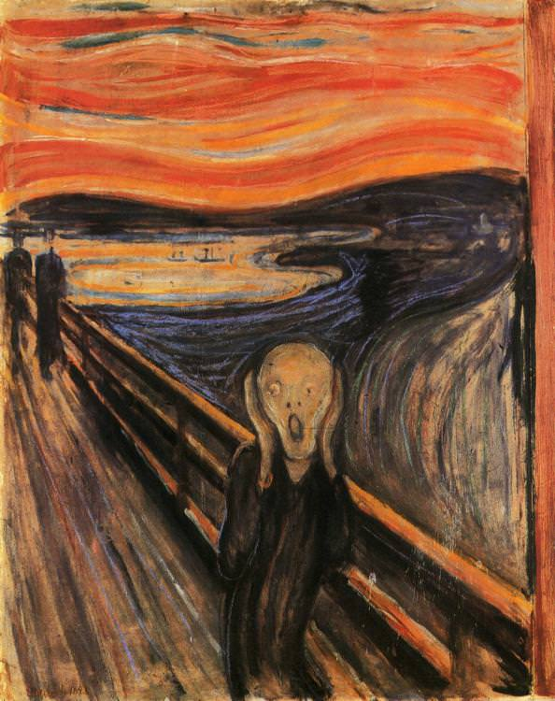
I have no idea how to do THIS!!!

Slide 4
stay with that Let it flow over you
Write a function to output a permutation of an array of numbers.
Each possible permutation should be equally likely.
What even is “permutation” anyway?

Slide 5

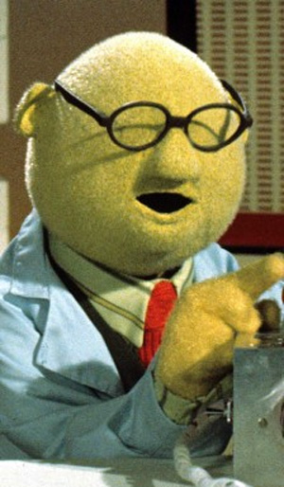
ADD THIS HAPPY thought
Write a function to output a permutation of an array of numbers.
Each possible permutation should be equally likely.
You are in a conference room.
At Amazon HQ, or Google, or Facebook: pick your nightmare.
There is an interviewer
Tick tock
Write a function to output a permutation of an array of numbers.
Each possible permutation should be equally likely.
And a whiteboard
And you

Slide 6
AND THIS IS QUESTION #1
Write a function to output a permutation of an array of numbers.
Each possible permutation should be equally likely.
There are six (6) hours of interviews to go.
tick tock
YOU ARE STUCK ON QUESTION 1
Write a function to output a permutation of an array of numbers.
Each possible permutation should be equally likely.

Slide 7
Design questions from a recent interview
Write a program to find the unique numbers in a set of files.
Input: 5 files of numbers. Each file is sorted, and may have duplicates
Output: File of numbers that are present in only one file.
Complication: The files are too big to fit in memory.
Write a function that to predict disk capacity needs.
Input: Two arrays. Array 1 disk capacity usage trend, Array 2. business cycle
Output: Array of recommended disk capacties for the next 12 months.
Write a function to accept or reject a product review and rating
Input: reviewer ID, product ID, review, rating.
Output: accept/reject
Rules:
Write a function that returns a permutation of an array of integers.
Input: array of integers Output: array containing permutation of same integers Complication: each possible permutation must be equally likely.
Write a function to find closest post office to person’s location.
Input: Location. Post office map: (name, location)
Assume: Grid street layout.
Complication: Millions of queries, the map is huge.
Write a program that finds customers who return to a website
Input: input two files containing logs of customer visits on different days.
Output: IDs of customers who returned to the site on the second day.
Complication: Input files are too large to fit in memory.
Review > 10 words
1 <= stars <= 5
Valid reviewer ID
Reviewer not banned
Valid product ID
Reviewer has bought product
more....
My brain is full and empty
at the same time

Slide 8
You’ll come up against ones like these as well
Remove a node from a linked list without using extra memory
Find the maximum sum sub-sequence in an array of integers
Count the “one” bits in an unsigned integer
Design the classes for an airline reservation system

Slide 9
Question 1
Write a function to output a permutation of an array of numbers.
Each possible permutation should be equally likely.
What do you do?

Slide 10

RULE 1

Slide 11
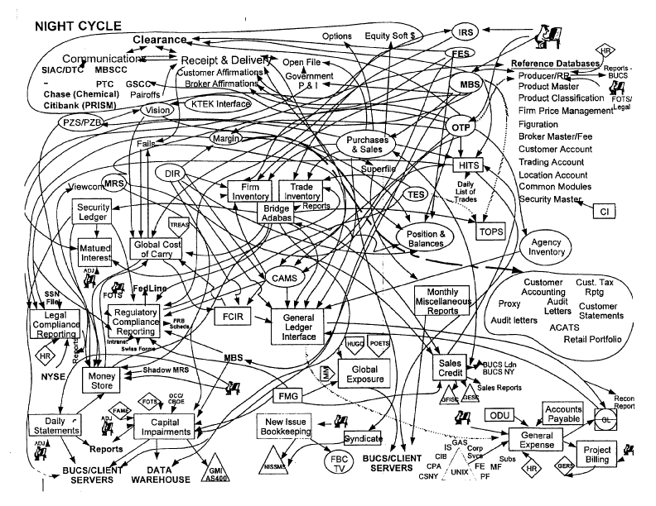
Rule 2
make a plan

Slide 12

Rule 3
Try Something

Slide 13

Approach
HARD PROBLEM
Knowledge
1
2
3
Job offer

Slide 14

Objection!!
Irrelevant!
These interviews have got nothing to do with how programming is actually done!
Au Contraire!
This is exactly how engineers tackle problems
Whiteboard
Questions
Ideas
Sketches
Pseudo code
False starts
Dead ends
Discussions
Agreements
Disagreements
Heroic Programmer
Starts Coding.

Slide 15
Approach
HARD PROBLEMS
Knowledge
engineering

Slide 16
Don’t Picnic?
RULE 1
Get used to not knowing
Be persistent
Embrace the struggle
Expect to get stuck
Slow down
Dig deep

Slide 17
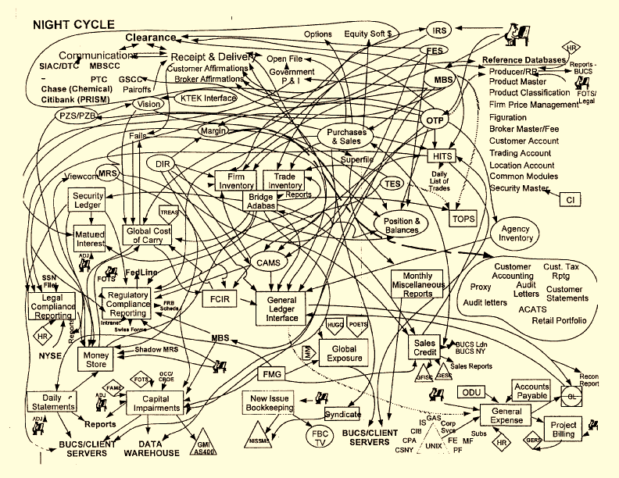
make a plan
PLAN “A”
Ask questions,
Start a dialog
Explore the limits
Test cases
Requirements:
Scale?
Speed?
Error handling?
Expected changes
Sketch:
Concept map
Components

Slide 18
Try Something
Start Writing
Top-level pseudo code
Break tricky stuff into smaller functions
Attack tricky stuff bit-by-bit

Slide 19
Try Something
Stuck?
Attack the smallest, easiest bit. Then extend.
What’s the simplest thing that would work?
What data structures fit?
What algorithms fit?

Slide 20
Try Something
Still Stuck?
What am I assuming (wrongly)?
What am I missing?

Slide 21
Try Something
IF ALL ELSE FAILS ASK YOURSELF:
What would an intelligent adult do
if one were here today?

Slide 22
Approach
HARD PROBLEM
Knowledge
Programming languages
Data structures
Algorithms
Big O estimates
Object-oriented design
Procedural design
1
2
3

Slide 23
Programming Languages
Get two languages down cold:
One procedural/functional
One object-oriented
Write code that is:
beautiful
simple
clear
mainstream
Make it read like pseudo code

Slide 24
Data Structures
BASIC
Arrays
Vectors
Linked Lists
Queues, Deques
Stacks
Binary Trees
Maps
Hash Tables
Sets
Heaps
Priority Queues
INTERMEDIATE
Graphs
Tries (Prefix trees)
TEACH YOURSELF
k-d Trees
Suffix trees
Consistent Hashing
Rolling Hashes
KNOW:
How they work
Big O performance
What problems they work on
Weaknesses

Slide 25
algorithms
BASIC
Arrays and sequences
Sum
Max/min
Longest/shortest subsequence
Searching
Linear search
Binary search
Sorting
Merge sort external files
Insertion sort
Bucket sort
Quicksort
INTERMEDIATE
Graphs
Breadth first search – shortest path
Dijkstra’s algorithm – cheapest path
Nearest Neighbor Search
KNOW
When to use them
How to implement them
Big O performance
Weaknesses
COMES UP EVERY TIME!

Slide 26
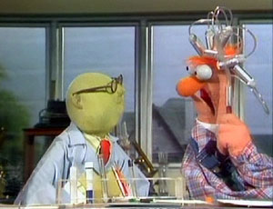
Behavioral questions
If you could win a lifetime achievement award 5 years from now, what would it be for?
What is more important: on time or right?
What is the most difficult project you have worked on?
Describe a time when your boss was wrong: what did you do about it?
Describe a time when a team member was not pulling their weight, was delivering faulty or unfinished work, what did you do about it?
Describe a time when you took shortcuts to get the job done.

Slide 27
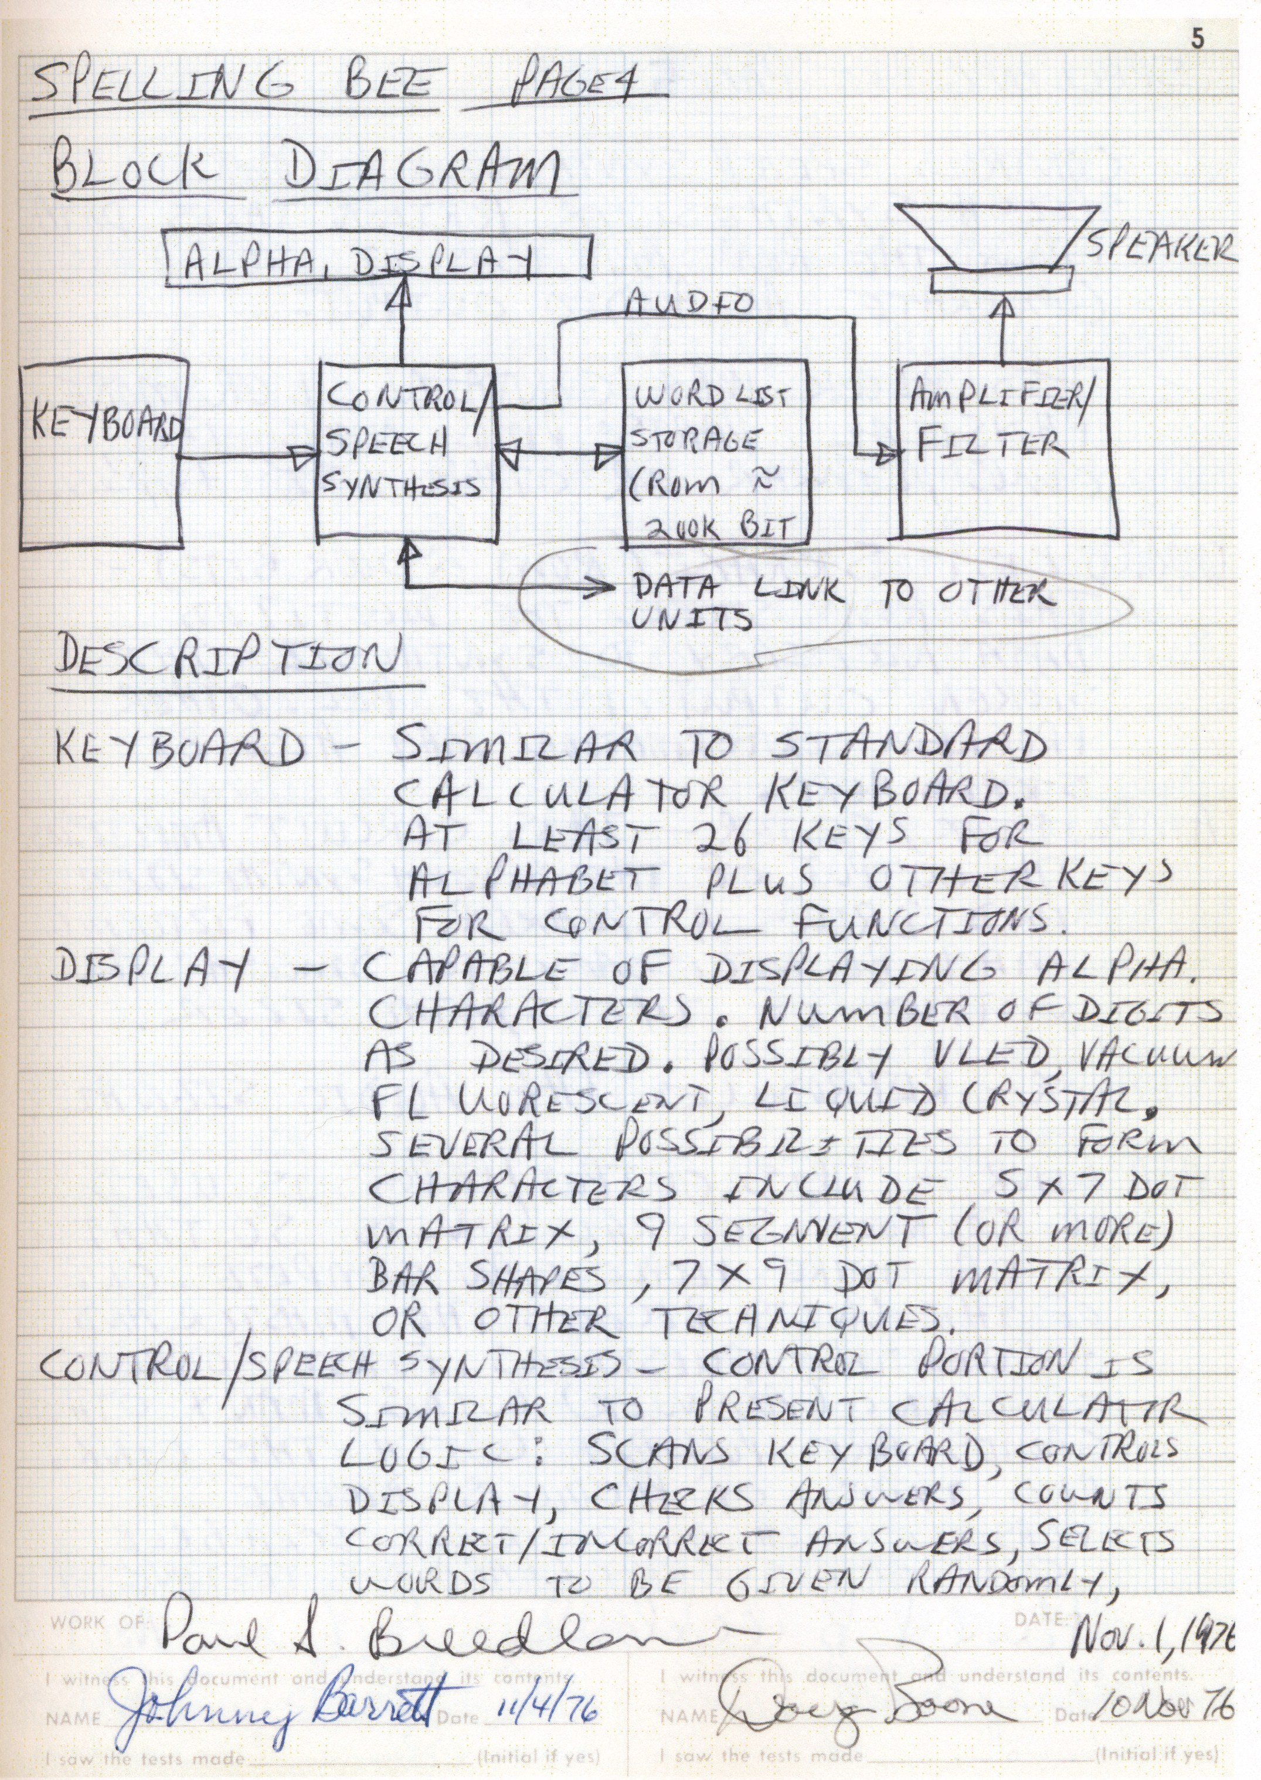
What you can do now
If at first you don’t succeed, no matter.
Try again.
Fail again.
Fail better.
[Samuel Beckett]
Think in a Design Notebook
Questions
Sketches
Experiments
Test cases
Concept maps
Pseudo code
Lessons learned
Practice Persistence
Get used to being stuck
Practice on hard problems
Slow down. Relish the details.
Dig deep. Look for deep understanding
Learn how to learn fast
Get interested
Teach yourself
Truly understand basics

Slide 28
How to Prepare
Get Interested
Algorithms
Data Structures
Practice Online
GeeksForGeeks.org
HackerRank.com
LeetCode.com
InterviewBit.com
Interview Prep Info
GeeksForGeeks.org
Elements of Programming Interviews. Aziz et al.
Algorithms in a Nutshell. O’Reilly

Slide 29
Write beautiful code

